Slide 1

Data Driven Education
Discussion Forum Subteam
Presentation 1 - 10/05/2022
Notes:
Pratik

Slide 2





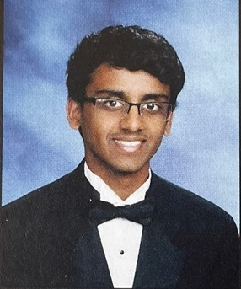
Team Members
Malav Patel
Data Scientist
Hyun Soo Kim
Data Scientist
Jisan Park
Data Scientist
Pratik Agarwal
Project Manager
Ankit Mishra
Front-end
Web Developer
Gautam Sugasi
Back-end
Developer
Ritika Gehani
Front-end
Web Developer
Notes:
All

Slide 3


Introduction
Discussion forums
  Online formats - primary source of interaction
Student interaction
  Cognitive presence
  Social presence
Activity on forums indicative of student engagement and interest
Goal: Creating a web application to help instructors save time on managing forums and increase cognitive engagement in their courses
Notes:
Pratik
Discussion forums are the primary source of class interaction in an online asynchronous course. The activity on these forums can be used as an indicator for assessing students’ engagement and understanding in the course. A popular framework in this context is the community of inquiry framework. It gives us a way to study how student learning takes place in online and blended environments. As shown in the diagram there are 3 components, cognitive presence, social presence and teaching presence.We’re focusing on the first two as of now. The goal here is to develop a web-based application which will help instructors get insights in almost real-time how students are engaging with the course and their sentiment on certain aspects, which can be used to improve the cognitive engagement levels in their courses.

Slide 4
Recap of Spring 2022
Category | Accomplished | Next Goals
Web Dev | Mockups ready for MVP dashboard | Pilot testing with real users (instructors) Integration with Piazza/Ed
UX Research | Conducted interviews and surveys with instructors Designed a mockup for testing | Create relevant metrics from forums data Pilot study on a real course
Data Science | Working models for cognitive presence, sentiment analysis and topic modeling | Aspect-Based sentiment analysis model and improve the cognitive presence model
Learnings and Challenges as a Project Manager:
Set expectations clearly at the start of semester for the team and each individual
Quicker iterations and faster feedback loops - focus on quick launch
Have clear deliverables each week from team members, no matter how small to make things concrete
Notes:
Pratik
In the previous semester, web-dev team was able to integrate the web-app with the Data Science team’s model working on real Piazza data and create mockups of our dashboard. In terms of UX research, we were able to collect a few survey results and couple interviews with instructors to help prioritize metrics for the dashboard. The data science team has managed to build 3 categories of models over the past few semesters for cognitive presence, sentiment analysis and topic modeling, which they’ll talk about in their respective section. As a project manager, there are a few aspects I’m working to improve on based on reflections from previous semester. Mainly setting clear measurable goals at the start rather than in the middle, quicker feedback loops, and better scheduling of tasks for each individual to minimize any bottlenecks in execution.

Slide 5
Focus for this semester
Development
  Deploy the web-app and test inside the Piazza sandbox environment
  Shorter feedback loops, try backtracking from goals to set individual deliverables and milestones
Research
  UX Research by connecting with instructor teams
Project Management
  Creating a documentation for the project to help future teams not having to reinvent the wheel
Notes:
Malav:
This semester our focus is to deploy a web-app with a fully mapped back-end to support professors with understand their classes. The specifics of the dashboard and the backend will be elaborated by the respective teams. The research will be performed to understand new requirements of the courses.

Slide 6
Data Science

Slide 7
Research Goal
Based on the community of inquiry framework, what are some key factors in discussion forum activities influencing student engagement and performance in an asynchronous online classroom?
How can we design a web app that can provide actionable insights to the instructor in order to increase engagement and performance?
Notes:
Malav
Our goal is to analyze student interaction with their peers and understand their engagement and performance in a classroom and provide visualized graphics data to the web-dev team using the previous cognitive presence and topic modeling results and aspect based sentiment analysis to understanding the interactions between students and professors. By the end of the semester, we want to provide graphics data from our analysis to the professors by integrating the results of these models. Also, we would like to complete the pipeline to avail this functionality in real-time on incoming Piazza data through a webapp in a real-time environment.

Slide 8
Data Science Big Picture
Data available
  Focusing on Piazza data from Dr. Thad Starner
  1493 posts, coded for cognitive presence and working on Topic Modeling
Cognitive Presence
Metacognition
Data Science
Topic Modeling
Aspect-Based Sentiment Analysis
Notes:
Jisan
multiple projects in data science
from last semesters, continuing work on cognitive presence and sentiment analysis
new research topics are topic modeling and ABSA
upcoming project is metacognition

Slide 9
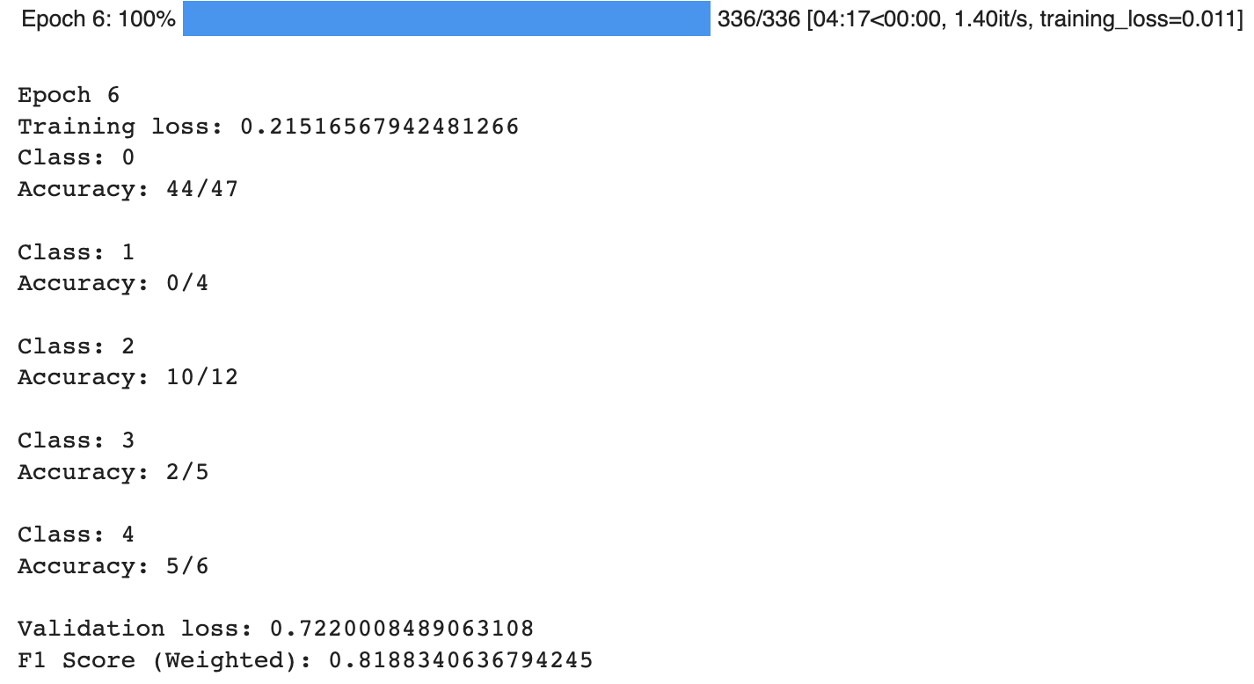
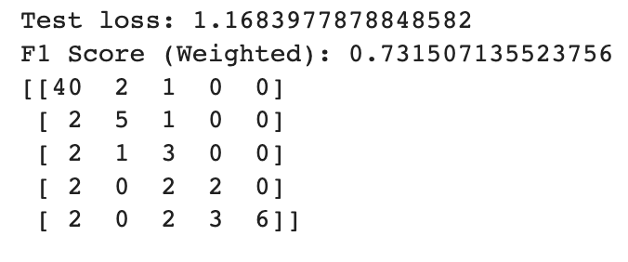
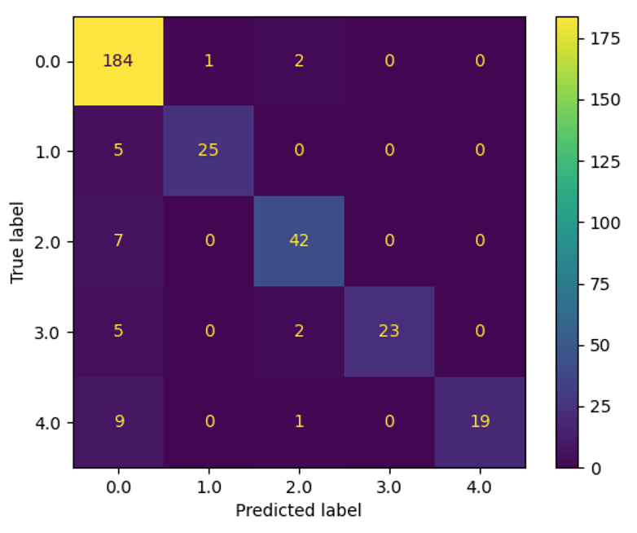
Data Science - Previous Work
Model to predict Cognitive presence
Test and train on Piazza data
Notes:
Jisan

Slide 10
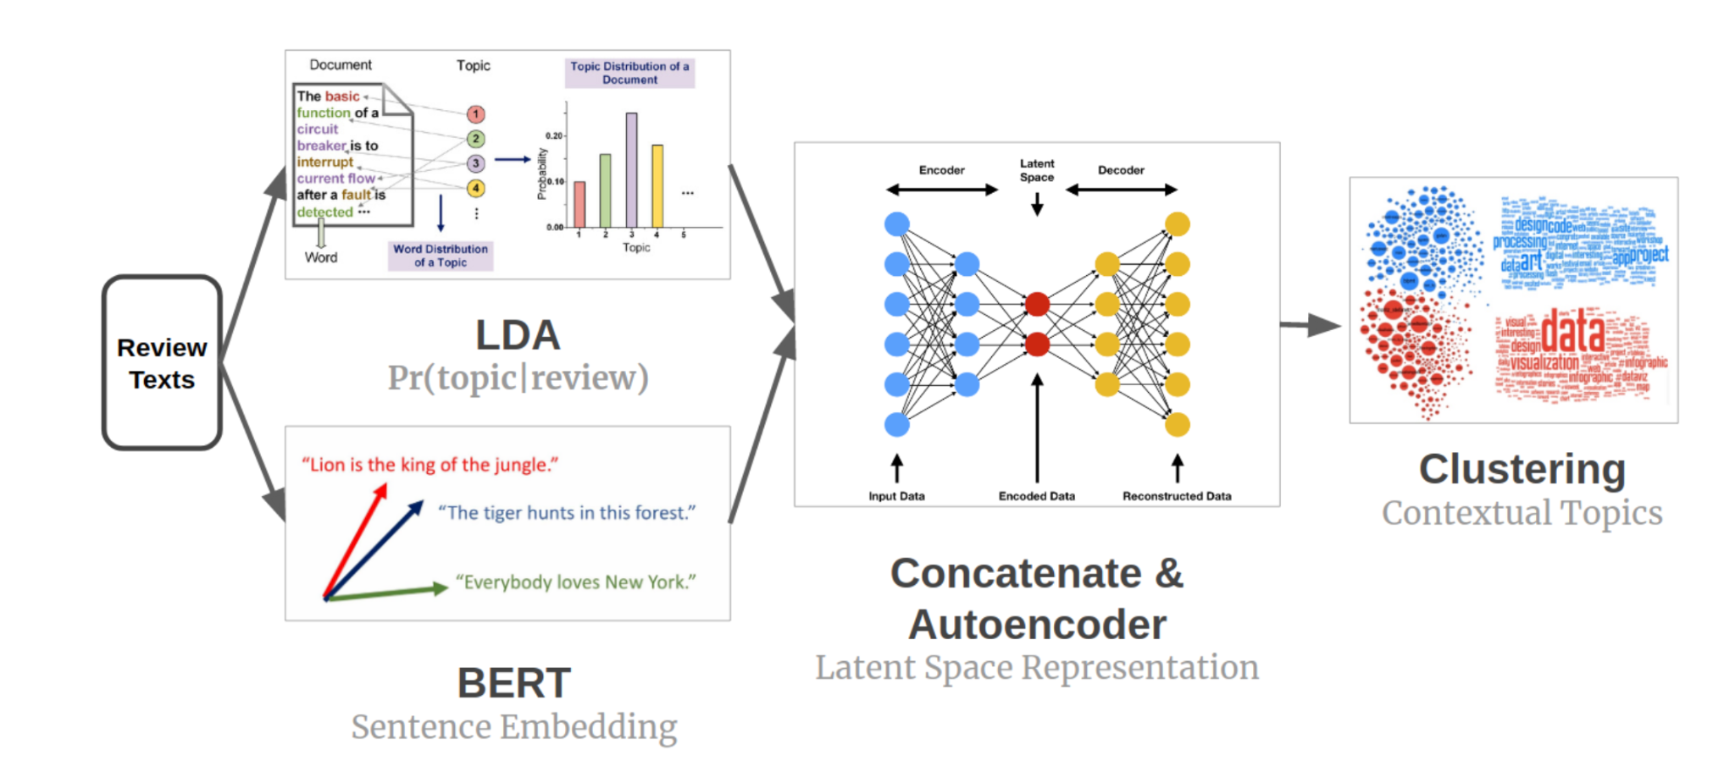
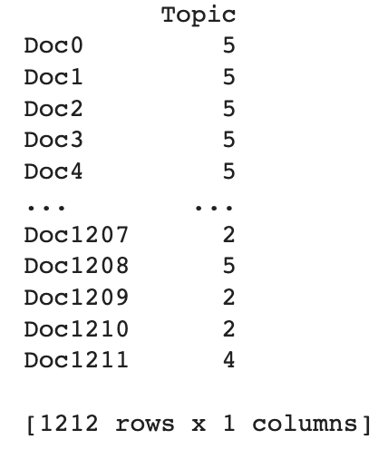
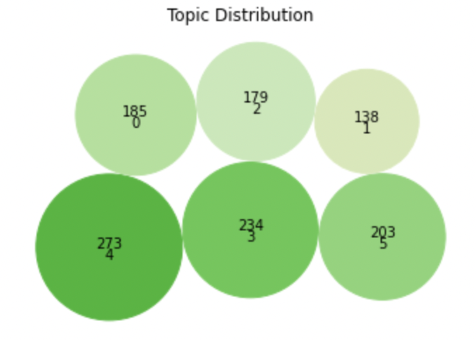
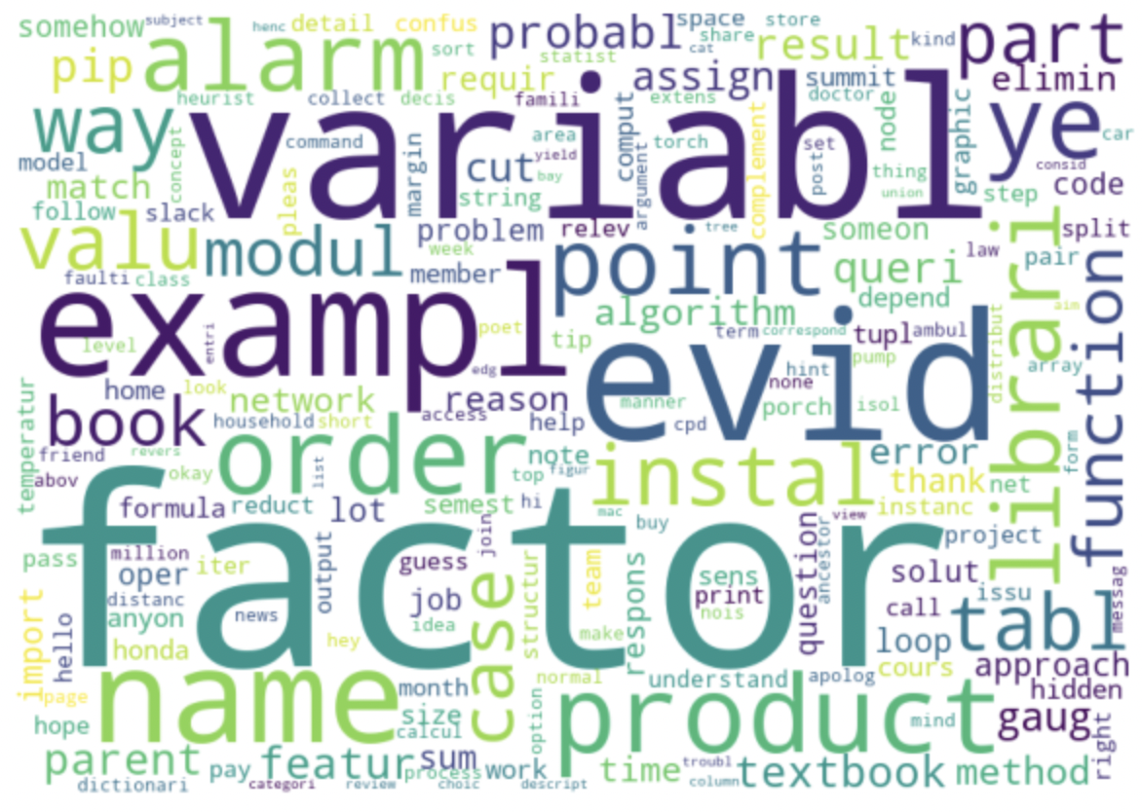
Data Science - Previous Work
Topic Modeling
  Visualization
    Topic by documents
    Word cloud
Notes:
Jisan
Mostly Topic modeling with LDA for probabilistic topic assignment vector and BERT for sentence embedding vector

Slide 11

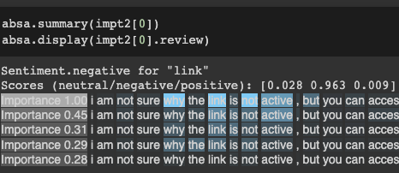
Aspect-based Sentiment Analysis
A machine learning task that identifies and assigns sentiment to aspects, features, and topics that it has categorized in the body of data
<Example>
Text: I am not sure why the link is not active, but you can access A4 here
Aspect: link
Output: neutral: 0.028, negative: 0.963, positive: 0.009
Notes:
Harriet
Aspect-based sentiment analysis is what we brought out this semester. It is a machine learning task that identifies and assigns sentiment to aspects, features, and topics that it has categorized in the body of data. It receives texts and aspects as inputs and returns the ratio on how positive, neutral, and negative they are. It is mostly used on evaluating reviews such as movie or restaurant review, but we are applying it on Piazza data.
The example you can see on the screen is one of the posts on Piazza for an AI class. It says that “I am not sure why the link is not active”, and when we put link as an aspect, then we can see that the output says negative, because the keyword “link” is being evaluated as negative.
We are planning on using our keywords from topic modeling as aspects, and we expect this to help collect students' opinions and evaluations on difficulty or teaching methods in respect of specific topics.

Slide 12
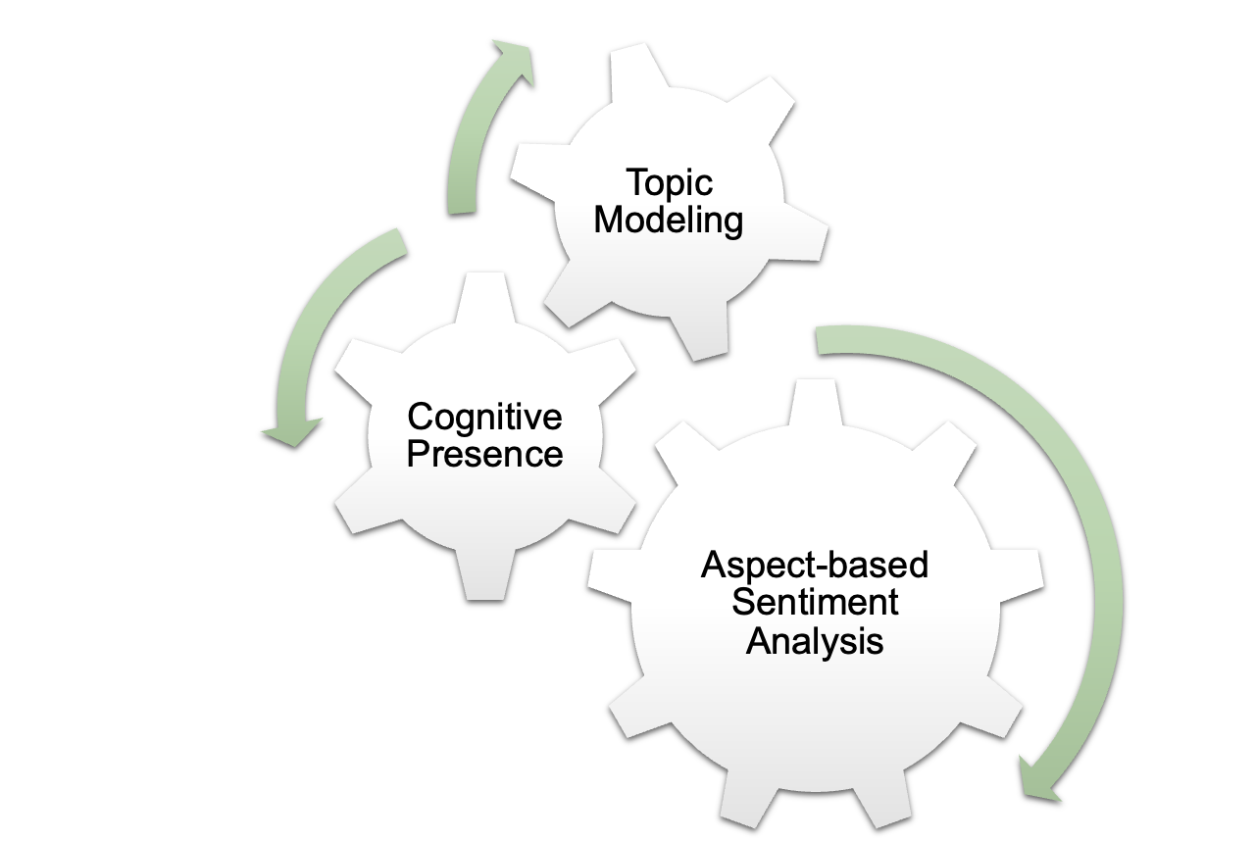



Overall Semester Goals
Notes:
Harriet
Our ultimate goal for this semester is to improve all topic modeling, cognitive presence, and aspect-based sentiment analysis and to actually build a pipeline from data science model to our web page dashboard. We are planning to generate our result as a .csv file to deliver our output to web-dev team.

Slide 13
UX Research

Slide 14
User Surveys & Interviews
Research Question: What metrics on a dashboard are useful to instructors in order to improve student engagement & performance and/or reduce workload for instructors?
Goals:
Collect ideas & insights from users on utility of metrics.
Find the intersection between valuable metrics and feasible metrics.
Pilot test prototypes with users.
Notes:
Gautam

Slide 15
User Surveys & Interviews - Previous Work
Conducted interviews with TAs & instructors from OMS classes
  Dr. Joyner, James Lohse, Vaibhav Bhosale
Gave out survey for feedback on metrics
Reported on:
  Metrics to include on dashboard
  Problems with using discussion forums
  Research topics for further investigation
Notes:
Gautam

Slide 16
Web Development

Slide 17
Last Semesters Results
Fetching piazza data from the backend database
High-fidelity mockups using Figma (design software)
  Allows us to test different information layouts and experiment with different ideas before deciding on a final one to code
  https://www.figma.com/file/E7GKzL49vurhk3X3XMFJBY/spring-2022-vip-mockups?node-id=0%3A1
Notes:
Gautam

Slide 18
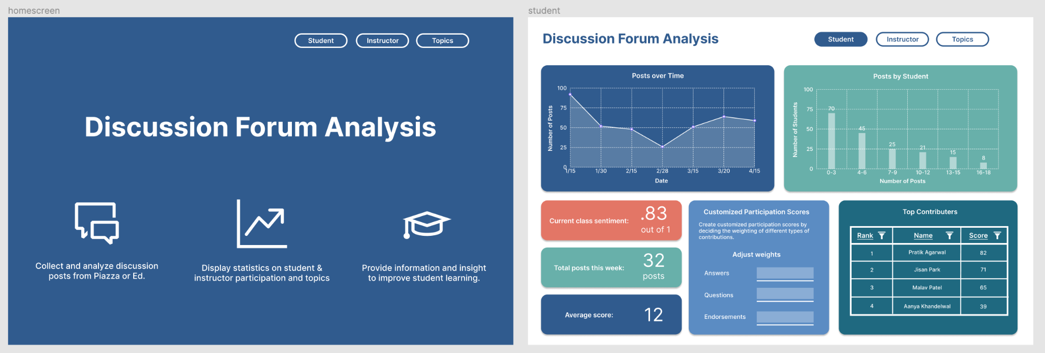
Last Semesters Results
Notes:
Gautam

Slide 19
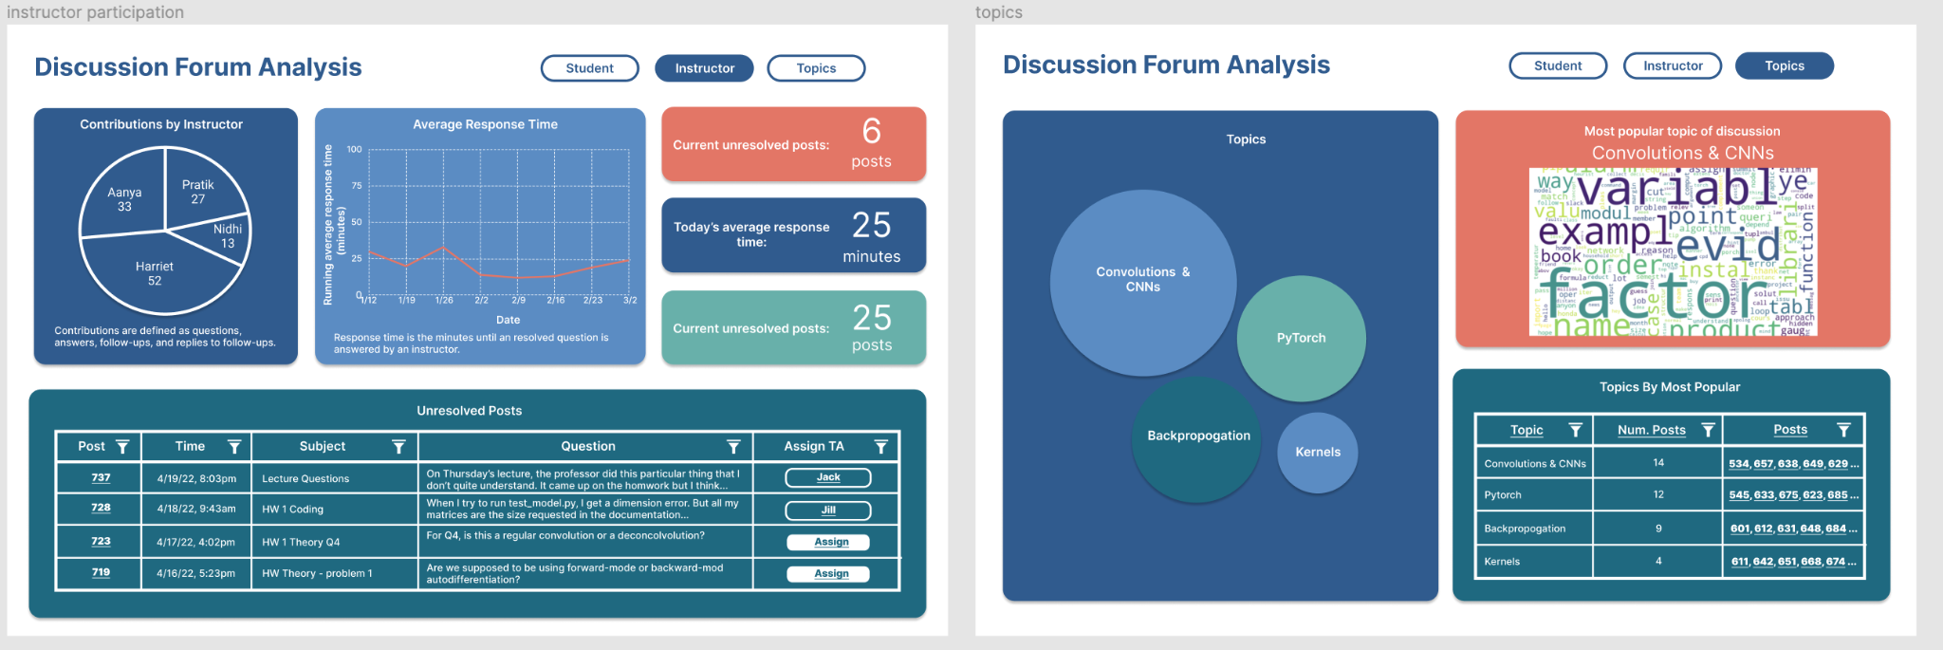
Last Semesters Results
Notes:
Gautam

Slide 20
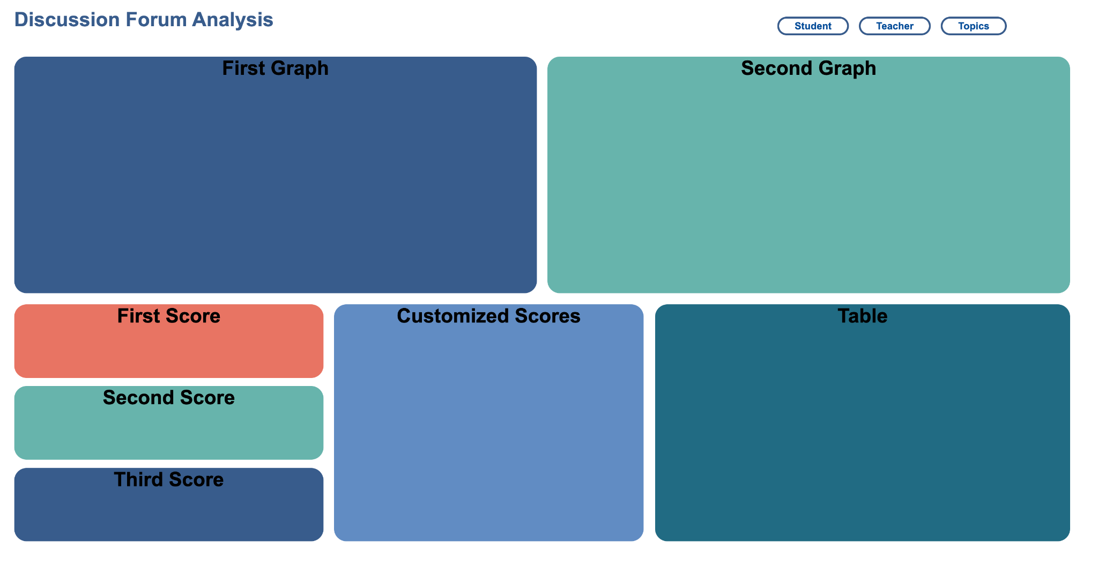
Current Progress
Notes:
Ankit

Slide 21
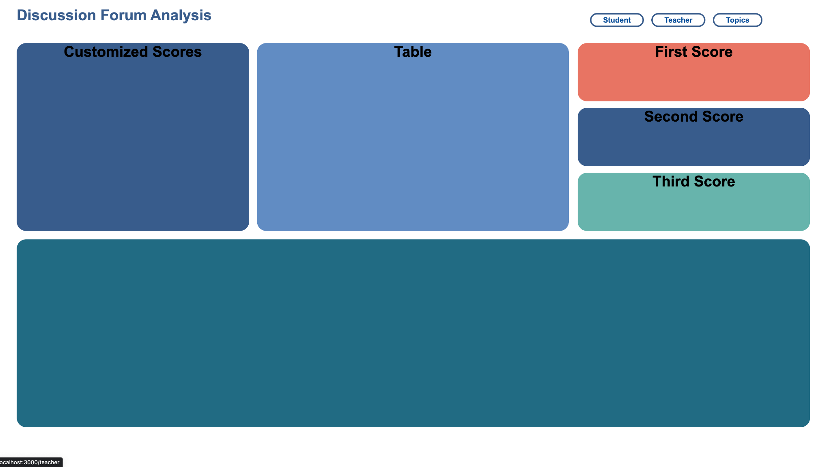
Current Progress
Notes:
Ankit

Slide 22
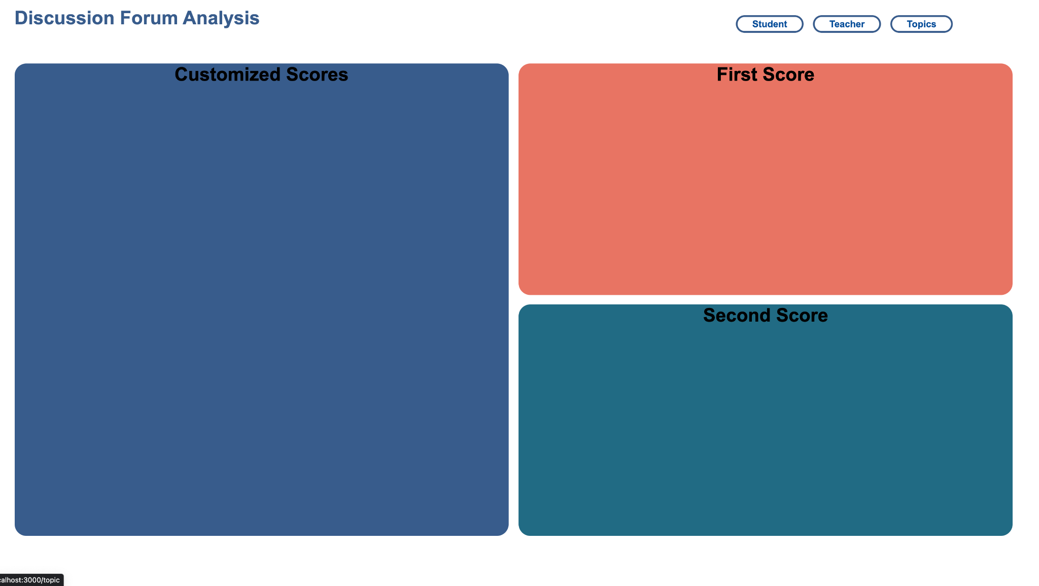
Current Progress
Notes:
Ankit

Slide 23
Conclusion
Project Roadmap
  Deployment of web-app and testing in Piazza sandbox environment and user feedback from instructor team
Model Development
  Aspect-Based Sentiment Analysis to help instructors get actionable insights on different aspects of their courses - assignments, instructor team, course materials, grading etc.
Piazza Feature
  Allow TAs to respond to an incoming question from the top matched responses from previous semester’s data using topic modeling
Notes:
Malav
To conclude, the next steps in the roadmap is getting the web-app deployed, and on the data science end, use aspect-based sentiment analysis to help instructors understand the discussion forum activity in a more granular fashion and get actionable insights based on “how are the students feeling about different aspects of the course”, like assignment quality, course materials, response time of instructors etc for example. Also if we get time, we want to continue using the topic modeling to provide a feature in Piazza that could suggest responses to the incoming questions based on the previous years data collected. Not all of this can be done in this semester but we’re trying to move towards it.

Slide 24
Citations
Garrison, D. R., Anderson, T., & Archer, W. (1999). Critical Inquiry in a Text-Based Environment: Computer Conferencing in Higher Education. The Internet and Higher Education, 2(2–3), 87–105. https://doi.org/10.1016/S1096-7516(00)00016-6
Garrison, D. R., Anderson, T., & Archer, W. (2001). Critical thinking, cognitive presence, and computer conferencing in distance education. American Journal of Distance Education, 15(1), 7–23. https://doi.org/10.1080/08923640109527071
Devlin, J., Chang, M. W., Lee, K., & Toutanova, K. (2018). Bert: Pre-training of deep bidirectional transformers for language understanding. arXiv preprint arXiv:1810.04805.
Medhat, Walaa, Hassan, Ahmed, Hoda, Korashy (2014). Sentiment analysis algorithms and applications: A survey. Ain Sham Engineering Journals. https://doi.org/10.1016/j.asej.2014.04.011
MacMillan, Kelsey, and James D. Wilson. Topic Supervised Non-Negative Matrix Factorization, Arxiv, 4 July 2017, https://arxiv.org/pdf/1706.05084.pdf.
Beri, Aditya. “Latent Dirichlet Allocation.” Latent Dirichlet Allocation, CodeChef-VIT, 27 Jan. 2021, https://medium.com/codechef-vit/latent-dirichlet-allocation-812bb8099518.

Slide 25
Questions?

Slide 26

Community of Inquiry
“a group of individuals who collaboratively engage in purposeful critical discourse and reflection to construct personal meaning and confirm mutual understanding”
Elements of an Educational Experience (Garrison et al., 1999)

